Slide 1
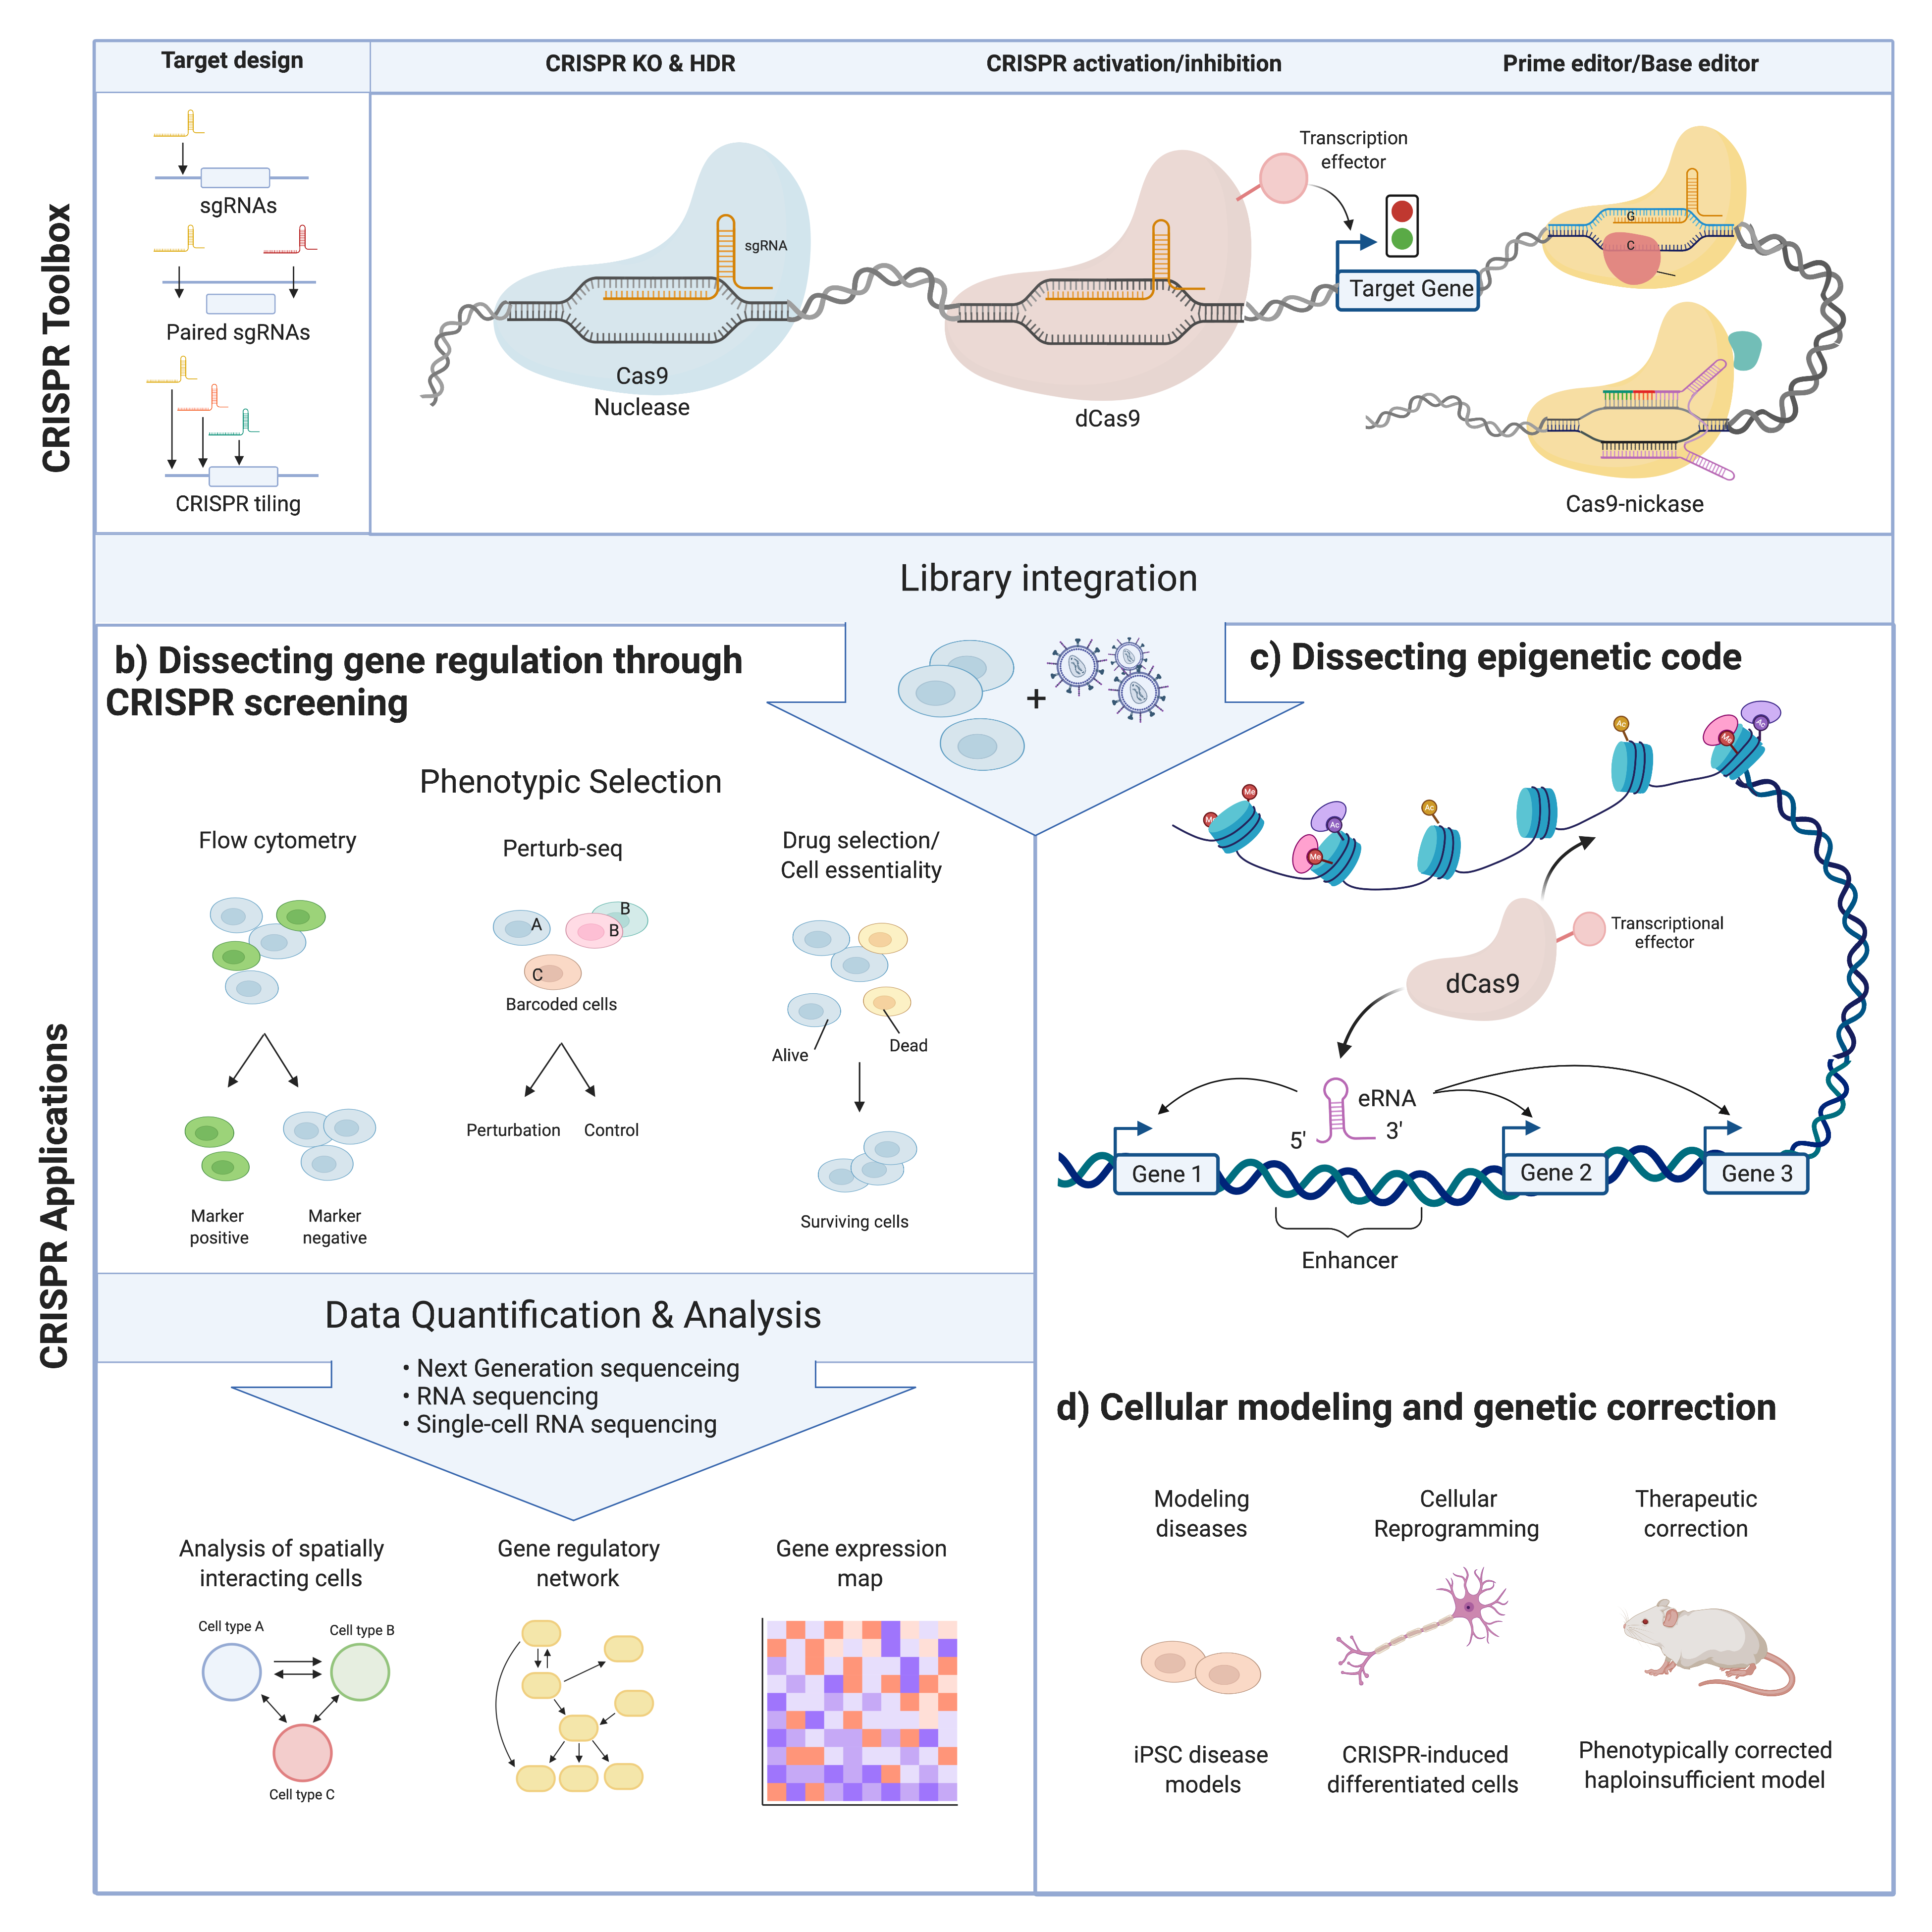
Lecture 8: High-throughput CRISPR screening
How can we use CRISPR tools to understand the human genome and its role in disease?
Ford et al 2018 JMB

Slide 2
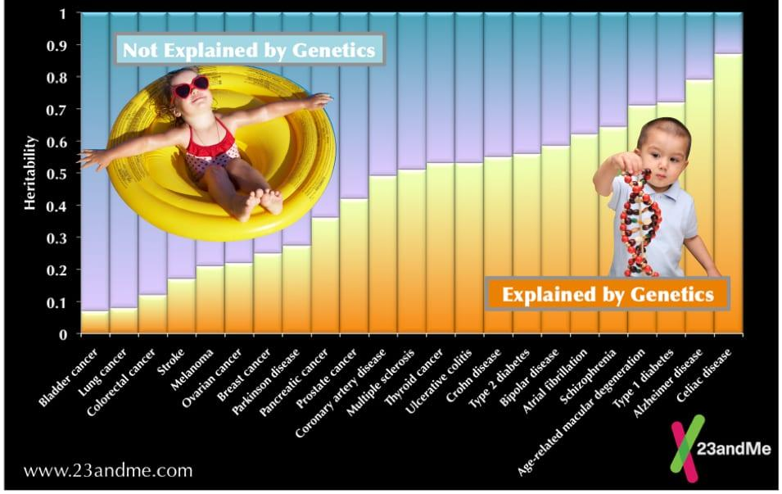
Disease risk is encoded in your genome

Slide 3
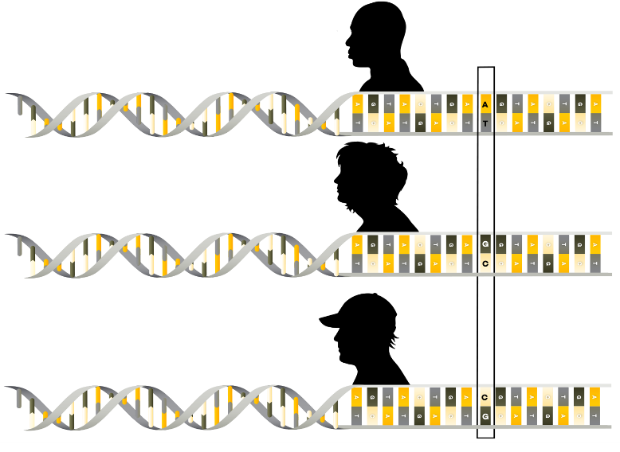
Disease risk is encoded in your genome
Your genome differs from your neighbor’s at 2-6 million positions
Your genome differs from your parents’ at 100-200 positions
1000 Genomes Project 2015 Nature
Porubsky et al 2025 Nature

Slide 4
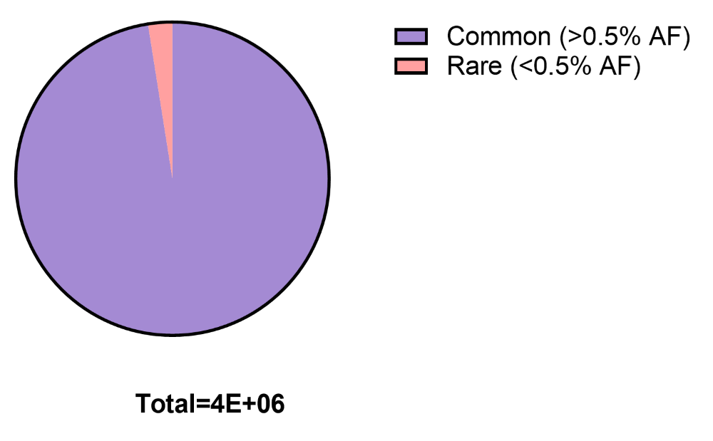
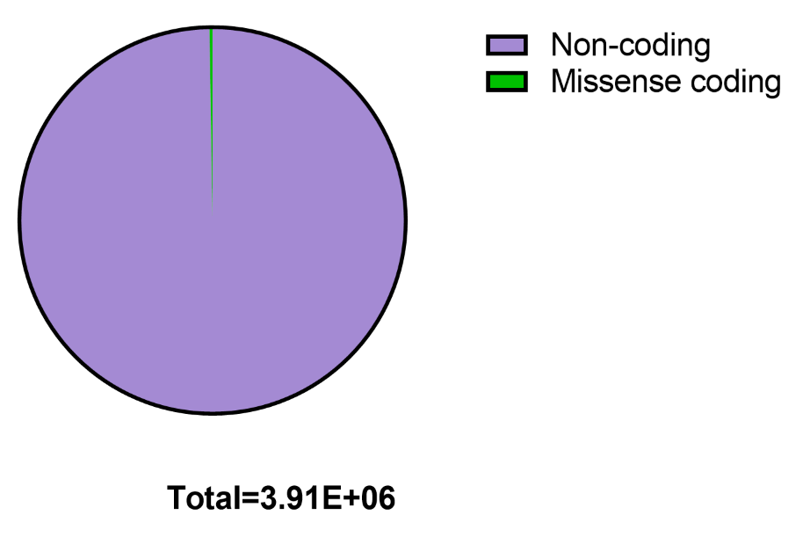
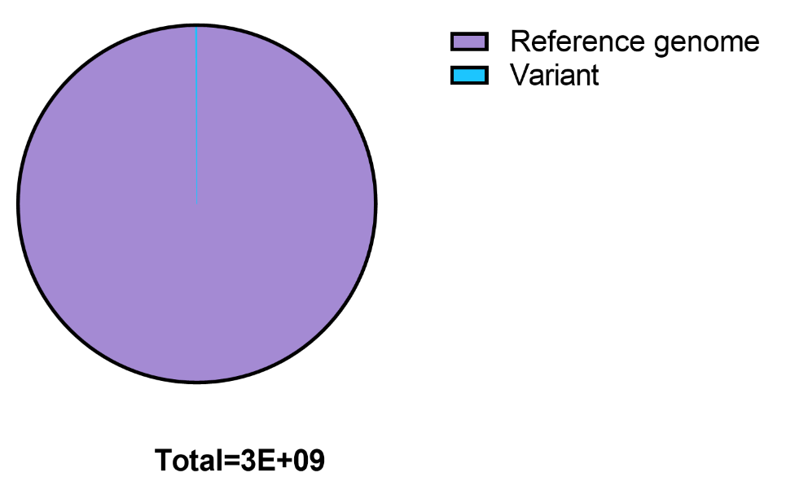
Disease risk is encoded in your genome
1-4% rare (<0.5% AF) variants
Population-wide, ~20M common variants, >100M rare variants
Common
variants
~4M differences from reference genome (a mosaic of 20 individuals from Buffalo, 70% from one man)
~10K missense coding variants
Outsized role in genetic disease
Non-coding variants
Human genome
3B bp
1000 genomes project Nature, 2015

Slide 5
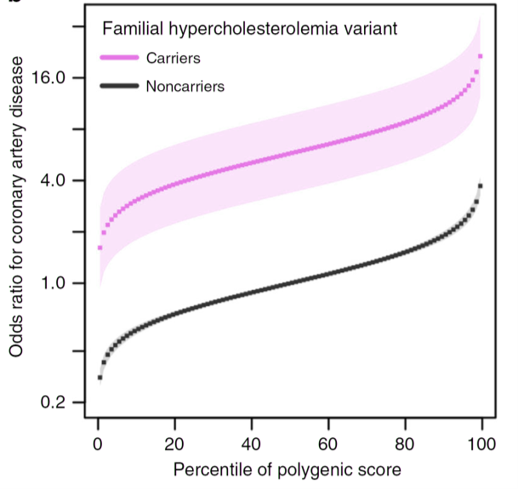
Common disease has monogenic and polygenic contribution
LDLR
PCSK9
Monogenic hypo/hypercholesterolemia
Rare (<1% of population), mostly coding variants in ~10 genes
Dramatic change in disease risk
Still, for majority of coding variants in disease genes, we can’t predict pathogenicity
Polygenic hypo/hypercholesterolemia
Common, mostly non-coding variants
Individually weak, collectively robust (10-fold range of disease risk)
~1,000 known loci. For most, we don’t know the causal variants and mechanisms
Fahed et al 2020 Nat Comms, Graham et al 2021 Nature, Berberich et al 2019 Nat Rev Cardio

Slide 6
Common disease has monogenic and polygenic contribution
Improved understanding of common disease genetics will enable:
Better prediction of individual disease risk
Genetic therapies for common diseases
Fahed et al 2020 Nat Comms, Graham et al 2021 Nature, Berberich et al 2019 Nat Rev Cardio

Slide 7
The genetics of cancer is still poorly understood
Why are certain genes associated with certain cancers? How do mutations in and around these genes change how cells work?
Do certain gene mutations make cancer cells particularly sensitive to certain treatments (synthetic lethality)?
How do cancer cells become resistant to treatments?
Martinez-Jimenez 2020 Nat Rev Cancer

Slide 8
Integrating CRISPR-Cas9 screening into human genetics
Association methods (GWAS, QTLs, coding burden) not sufficiently powered even if done on every human
We must edit the genome
Akinci, Hamilton et al 2021 Development

Slide 9
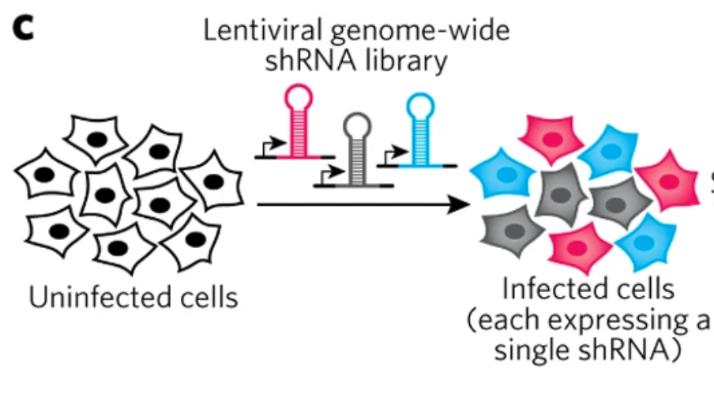
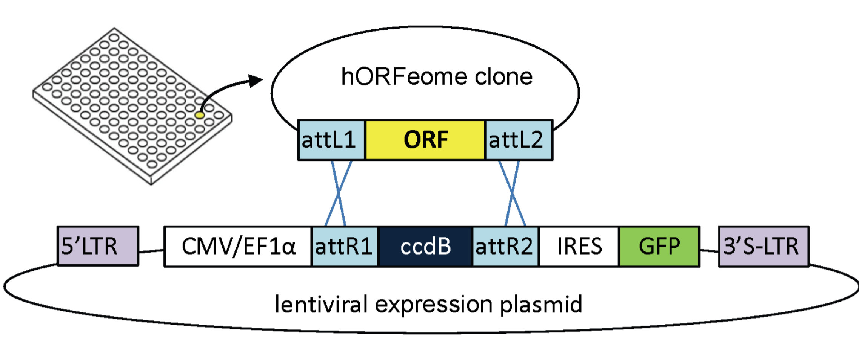
What was the screening landscape pre-CRISPR?
Loss-of-function: shRNA screening
Gain-of-function: ORFeome screening
What are the limitations of these approaches?
shRNA screening has variable efficiency and promiscuous and unpredictable off-targets
Only allows LOF of coding sequences. No good way to screen non-coding sequence
ORFeome screening is difficult to scale, especially for large genes
Platforms to modify sequence (not strict LOF or GOF) very cumbersome
Deans et al 2016 Nat Chem Bio, Skalamera et al 2011, PLOS One

Slide 10
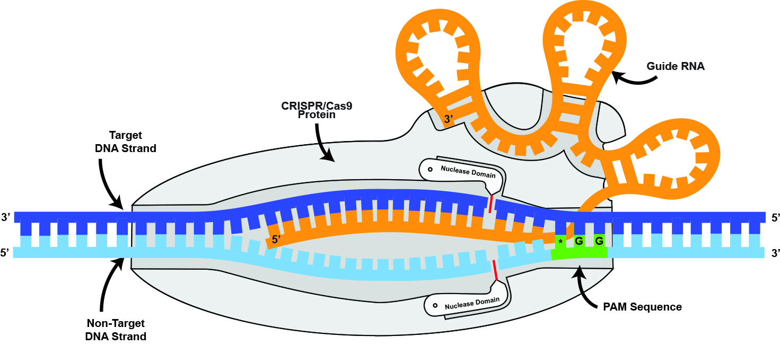
CRISPR-Cas9 genome editing
Notes:
And that’s how it works with Cas9 genome editing as well. First, the protein scans across the genome to find its PAM sequence. Then whenever it encounters one, it pauses to unwind the first five proximal nts to see whether it matches with the sgRNA. If so, it keeps going for another 5, and if that looks good it unzips the remaining most distal 10. For this reason, sgRNA mismatches are most tolerated in the distal 10nt, while the seed region, which are the 10 most proximal nucleotides, can typically only tolerate one or at most two mismatches.
When it finds its (near) perfect match, the two nuclease domains of Cas9 each cut one strand of the DNA, between 3 and 4bp upstream of the PAM, and then the complex falls off.
Now you might still be wondering, why all this excitement and effort, in ZFNs, TALENs, and CRISPR, for cutting up DNA?

Slide 11
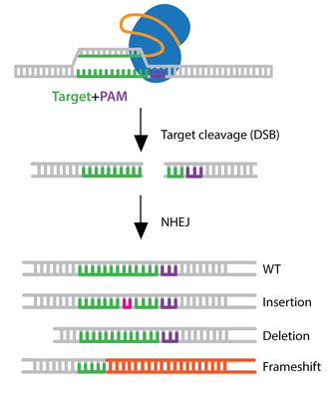
Cutting DNA
Knock out a gene
Cause an insertion or deletion
In most cases, renders gene non-functional
Addgene.org
Notes:
Well, historically, genetic knockouts have been our most powerful method of understanding their function. When we create a DSB in a cell using something like Cas9, it results in erroneous DNA repair that messes up that area of the DNA which can alter some amino acids, or if it causes a frameshift it can completely destroy the protein from their on out. Everything from individual gene or motif knockouts, to genome-wide knockout screens have given us immeasurable new insight into cell-type specific gene function, and the very first CRISPR drug to come to market is in fact a genomic knockout of a gene regulatory motif.
- The other major excitement surrounding site-directed DSB formation was the promise of using this for targeted gene insertion. Through homology directed repair, a DNA repair mechanism that is infrequently utilized by rapidly dividing cells, a DNA template assists in resolving a DSB and thus by providing a DNA donor, you could achieve knock-in of even gene-sized cargos into the genome. This works, a bit in some cells, but despite major efforts has sadly never quite come to fruition as an effective method of gene editing.

Slide 12
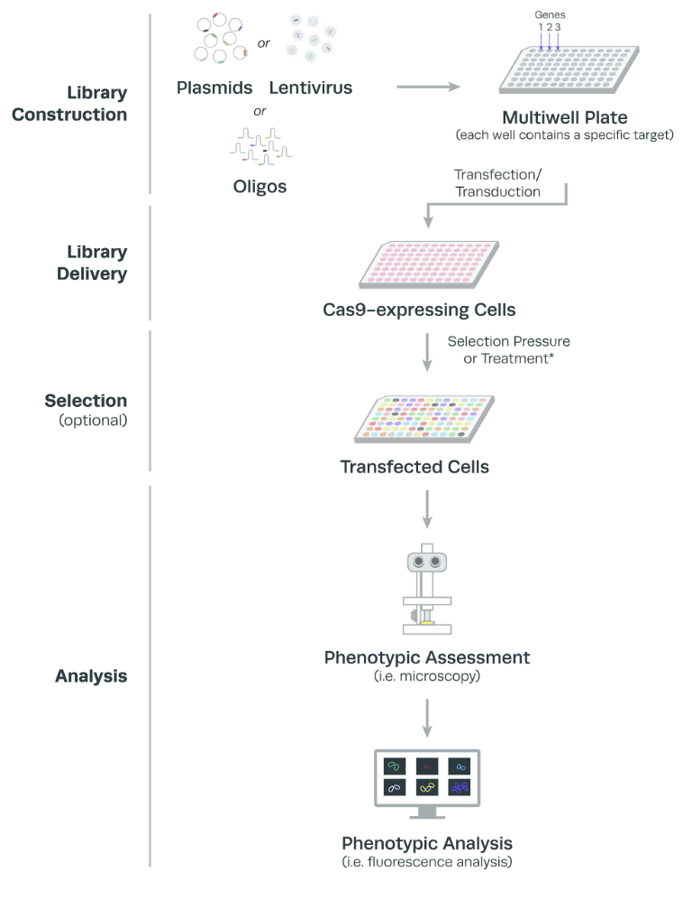
Arrayed CRISPR screening
Easy to move from individual experiment to small screen
Enables wide variety of phenotypic readouts
Direct interpretation of results (no need to use nextgen sequencing and computational analysis)
Difficult to scale to large number of perturbations
www.synthego.com

Slide 13
Pooled CRISPR screening
Highly scalable up to genome-wide
Efficient to evaluate many perturbations at once
Requires use of nextgen sequencing and computational analysis to process data
Must devise pooled phenotypic assays that enable distinguishing which gRNAs do and do not show effects
Peng et al 2015 FEBS

Slide 14
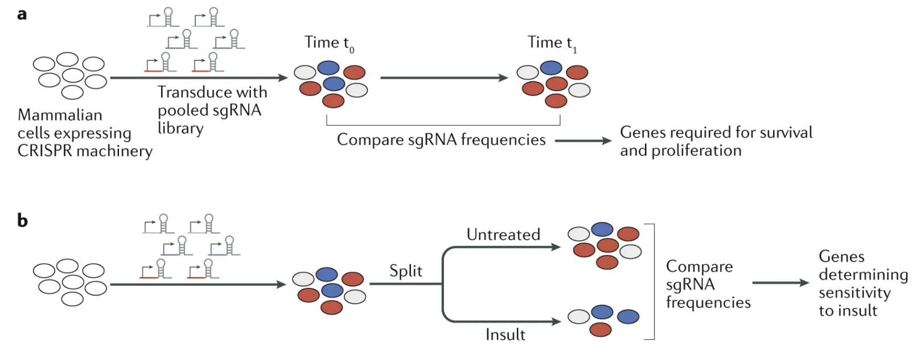
Types of CRISPR screens: growth-based
Kampmann 2020 Nat Rev Neurol

Slide 15
The first genome-wide CRISPR dropout (cell-essential) screen
What would you need to consider when designing Cas9-nuclease gRNAs for gene KO screening?
Dropout
Shalem et al 2014 Science

Slide 16
The first genome-wide CRISPR dropout (cell-essential) screen
What would you need to consider when designing Cas9-nuclease gRNAs for gene KO screening?
Constitutive exons
Not 1st or last exon
Cutting efficiency
Likelihood of frameshift
Off-targets (mitigated by averaging out of multiple gRNAs/gene)
Generations of genome-wide Cas9-nuclease libraries with improved potency have been developed
Shalem et al 2014 Science

Slide 17
The first genome-wide CRISPR enrichment (drug resistance) screen
Mutations in these genes could mediate PLX resistance in patients
Shalem et al 2014 Science

Slide 18
Comparing cell-essential genes between cancer cell lines can reveal unique dependencies and vulnerabilities
Chronic myelogenous leukemia (CML) commonly caused by BCR-ABL translocation (constitutively active ABL). Imatinib (Gleevec) is small molecule ABL inhibitor
Other CML-specific hits are downstream in ABL signaling pathway
Wang et al 2015 Science

Slide 19
Patterns in essentiality suggest cancer dependencies and drug targets
Genome-wide cell-essential CRISPR screening in 339 cancer cell lines
WRN KO specifically inhibits growth of cancers with microsatellite instability (MSI) caused by mismatch repair gene deficiency
WRN could be promising therapeutic target for MSI cancers
Behan et al 2019 Nature

Slide 20
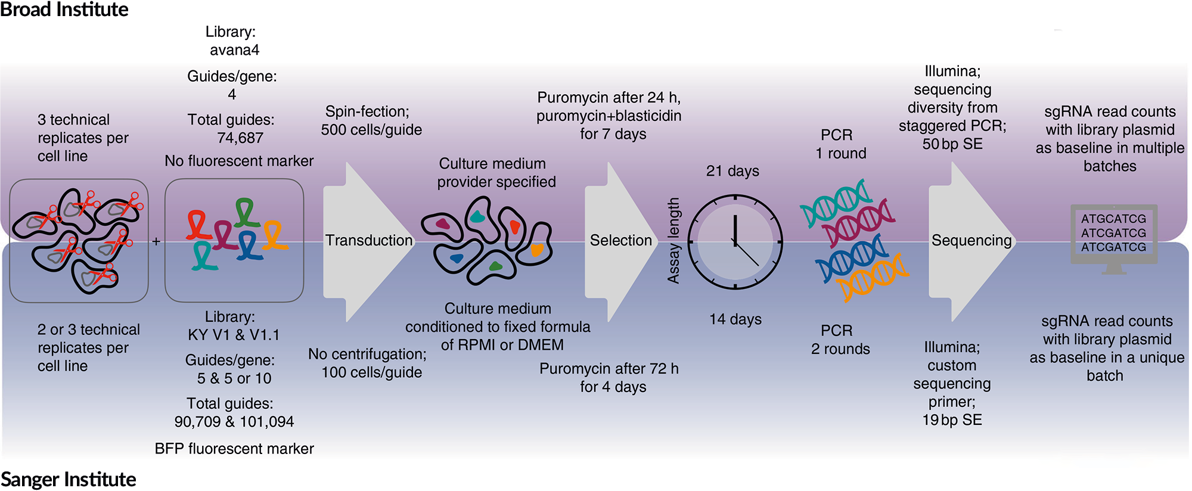
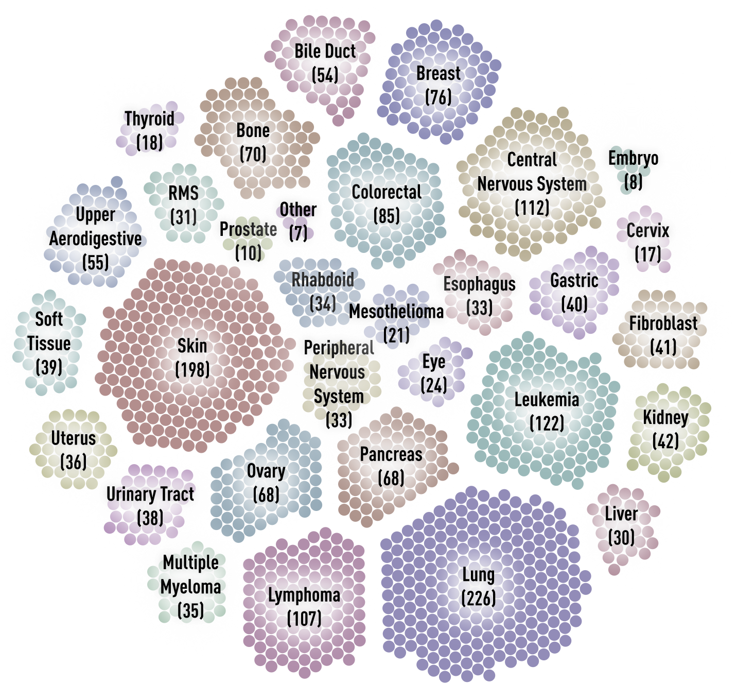
Scaling up cell-essential CRISPR screens
Cell-essential screens now available for >1,000 cancer cell lines
What could you do with such a large body of CRISPR KO data?
Tsherniak et al 2017 Cell, depmap.org

Slide 21
Co-essentiality reveals which genes have similar functions
Dependency analysis examines relationship between gene and cell line (WRN <--> MSI lines)
Co-essentiality examines relationship between each pair of genes (~18K*18K) across all cell lines
If two genes show similar (correlated) essentiality across all cell lines, they are likely involved in same biological process
Wainberg et al 2021 Nat Genet

Slide 22
Co-essential modules can be used to reveal functions of uncharacterized genes
A cluster of co-essential genes comprises all known enzymes in plasmalogen synthesis… AND one uncharacterized protein
TMEM189 KO cells show exact chemical build up and deficit pattern expected of mystery PEDS enzyme
What cellular functions is co-essentiality best or worst suited to uncover?
Wainberg et al 2021 Nat Genet

Slide 23
Co-essential modules can be used to reveal functions of uncharacterized genes
A cluster of co-essential genes comprises all known enzymes in plasmalogen synthesis… AND one uncharacterized protein
TMEM189 KO cells show exact chemical build up and deficit pattern expected of mystery PEDS enzyme
What cellular functions is co-essentiality best or worst suited to uncover?
Worst suited to discover cell type-specific functions and functions that do not impact cell growth/survival
Wainberg et al 2021 Nat Genet

Slide 24
Genetic interaction maps similar to co-essentiality in defining genes with similar function
Matrix of dual gene CRISPRi essentiality screening
Genetic interactions are cases where phenotype is weaker or stronger than would be predicted by individual gene phenotypes
Horlbeck et al 2018 Cell

Slide 25
Cell-essential CRISPR screen summary
Use CRISPR-KO or CRISPRi
Generations of gRNA library design have led to consistent, efficient LOF for all genes
Measure gRNA abundance at early and late timepoints as surrogate for essentiality of gene product
Use to reveal cancer type-specific vulnerabilities
Dual-gene or gene*drug screening can reveal key interactions
Co-essentiality is a surprisingly powerful way of annotating which genes play roles in the same cellular functions/pathways

Slide 26
Key caveat: cancer cell lines can be a poor surrogate for human biology
3D screen results more similar to known cancer gene effects than 2D screens
Han et al 2020 Nature

Slide 27
CRISPR growth alteration screens can be performed in vivo
Genome-wide CRISPR-KO treated cancer cells transplanted into mice with or without functional immune system
gRNAs that dropout specifically in immune-competent mice = genes whose KO potentiates cancer immunotherapy (e.g. PTPN2)
What to make of gRNAs that expand in immune-competent mice?
gRNAs that expand in immune-competent mice = genes required for cancer immunotherapy (e.g. PD-L1, CD47)
Manguso et al 2017 Nature

Slide 28
The CRISPR toolbox has expanded beyond Cas9-nuclease
Each technology has benefits and drawbacks

Slide 29
What reasons might there be to use other CRISPR modalities?
Attaching enzymes to dCas9 can change epigenome (e.g. which genes are expressed by a given cell)
KRAB domains are epigenetic repressors derived from zinc finger transcription factors
Akinci et al 2021 Development
What are benefits and drawbacks of CRISPRi vs. CRISPR-KO?
CRISPRi gRNAs can show more phenotypic consistency than CRISPR-KO gRNAs due to lack of genotypic heterogeneity (some indels preserve frame, others cause chromosomal loss)
But CRISPRi does not induce full loss of gene function

Slide 30
What reasons might there be to use other CRISPR modalities?
CRISPR activation (CRISPRa) uses fusions of dCas9 with potent transactivation domains
Example data comparing CRISPR-KO vs. CRISPRa on same assay
Why might a gene show up as a hit in CRISPRa screen but not CRISPR-KO screen?
Hamilton et al 2023 Cell Genomics

Slide 31
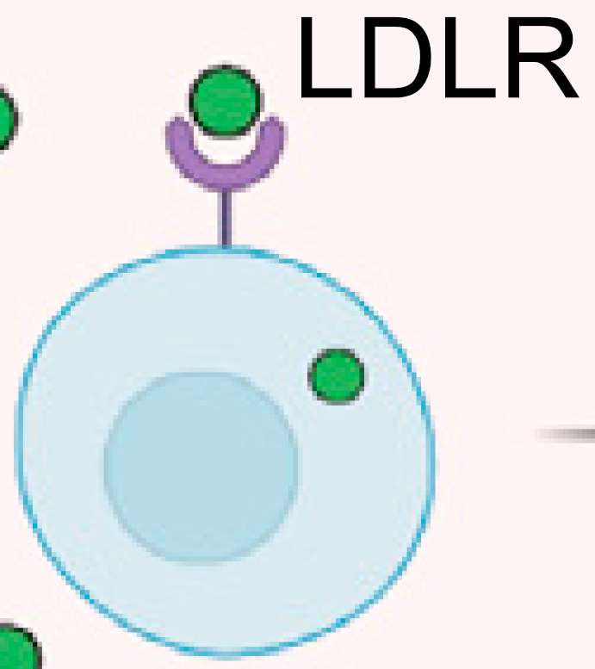
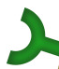
Why might a gene show up as a hit in CRISPRa screen but not CRISPR-KO screen?
Not expressed strongly in target cell line but capable of changing cell behavior
SCARB1

Slide 32
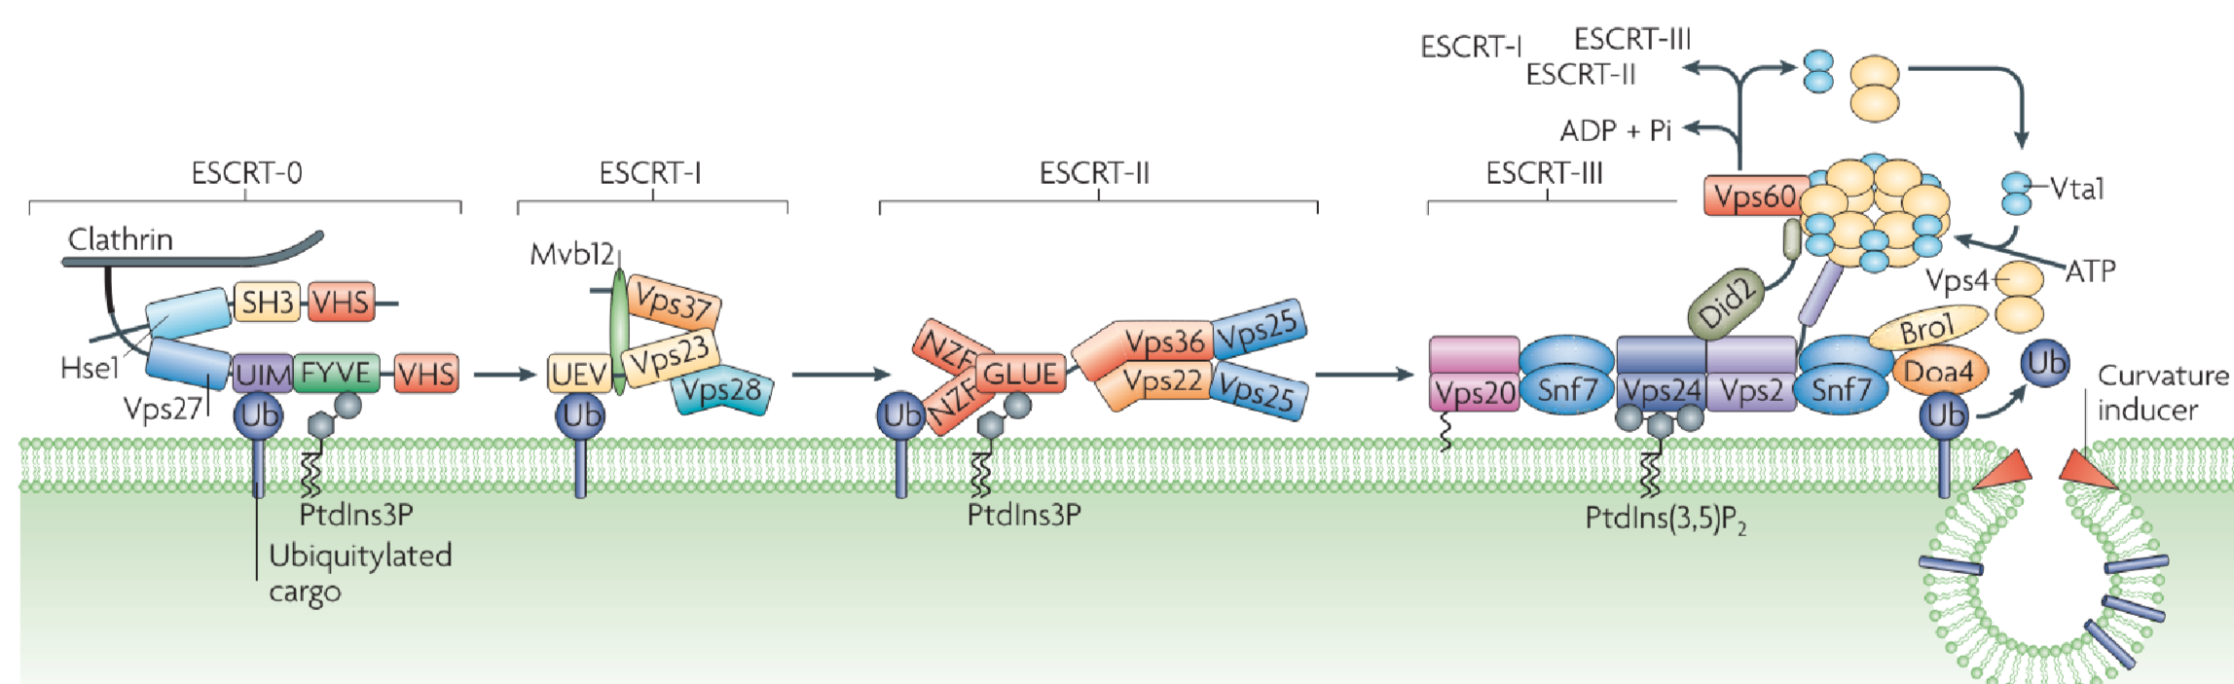
Why might a gene show up as a hit in CRISPR-KO screen but not CRISPRa screen?
Necessary cog in a process but must act in concert with other players
Williams and Uribe 2007, Nat Rev MCB

Slide 33
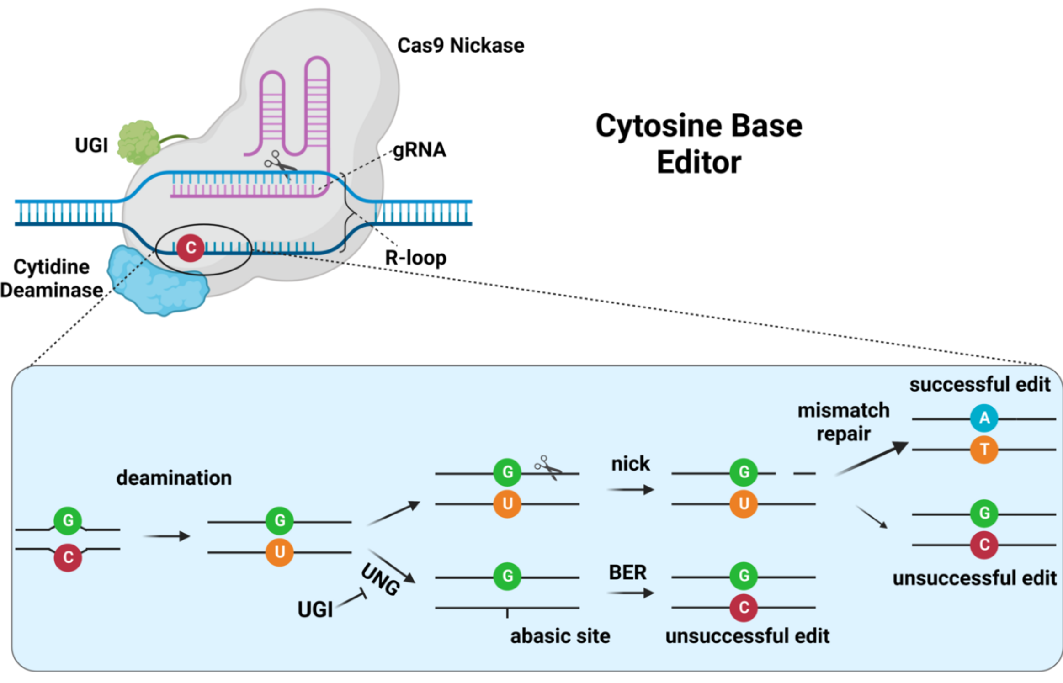
What reasons might there be to use other CRISPR modalities?
Base editing vs. CRISPR-KO/CRISPRi
Crisprmedicinenews.com

Slide 34
Tiled base editing screens reveal key protein regions
Tiled base editing of entire 53BP1 coding region reveals positions that alter interaction with USP28, thereby altering doxorubicin sensitivity
Can be used to distinguish pathogenic vs. benign genomic variants
No way to get this amino acid-level resolution with RNAi, CRISPR-KO, or CRISPRi
Cuella-Martin et al 2021 Cell

Slide 35
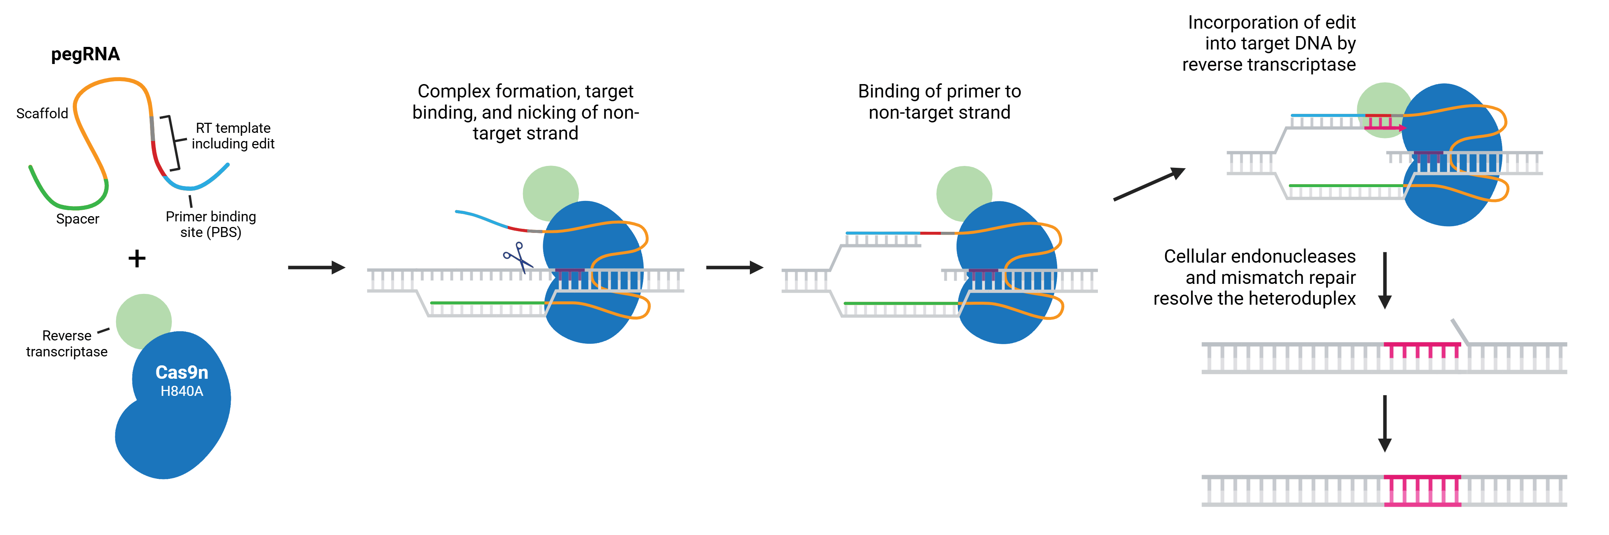
Prime editing: search and replace gene editing
Prime editing harnesses reverse transcriptase to write sequences into genome
Addgene.com

Slide 36
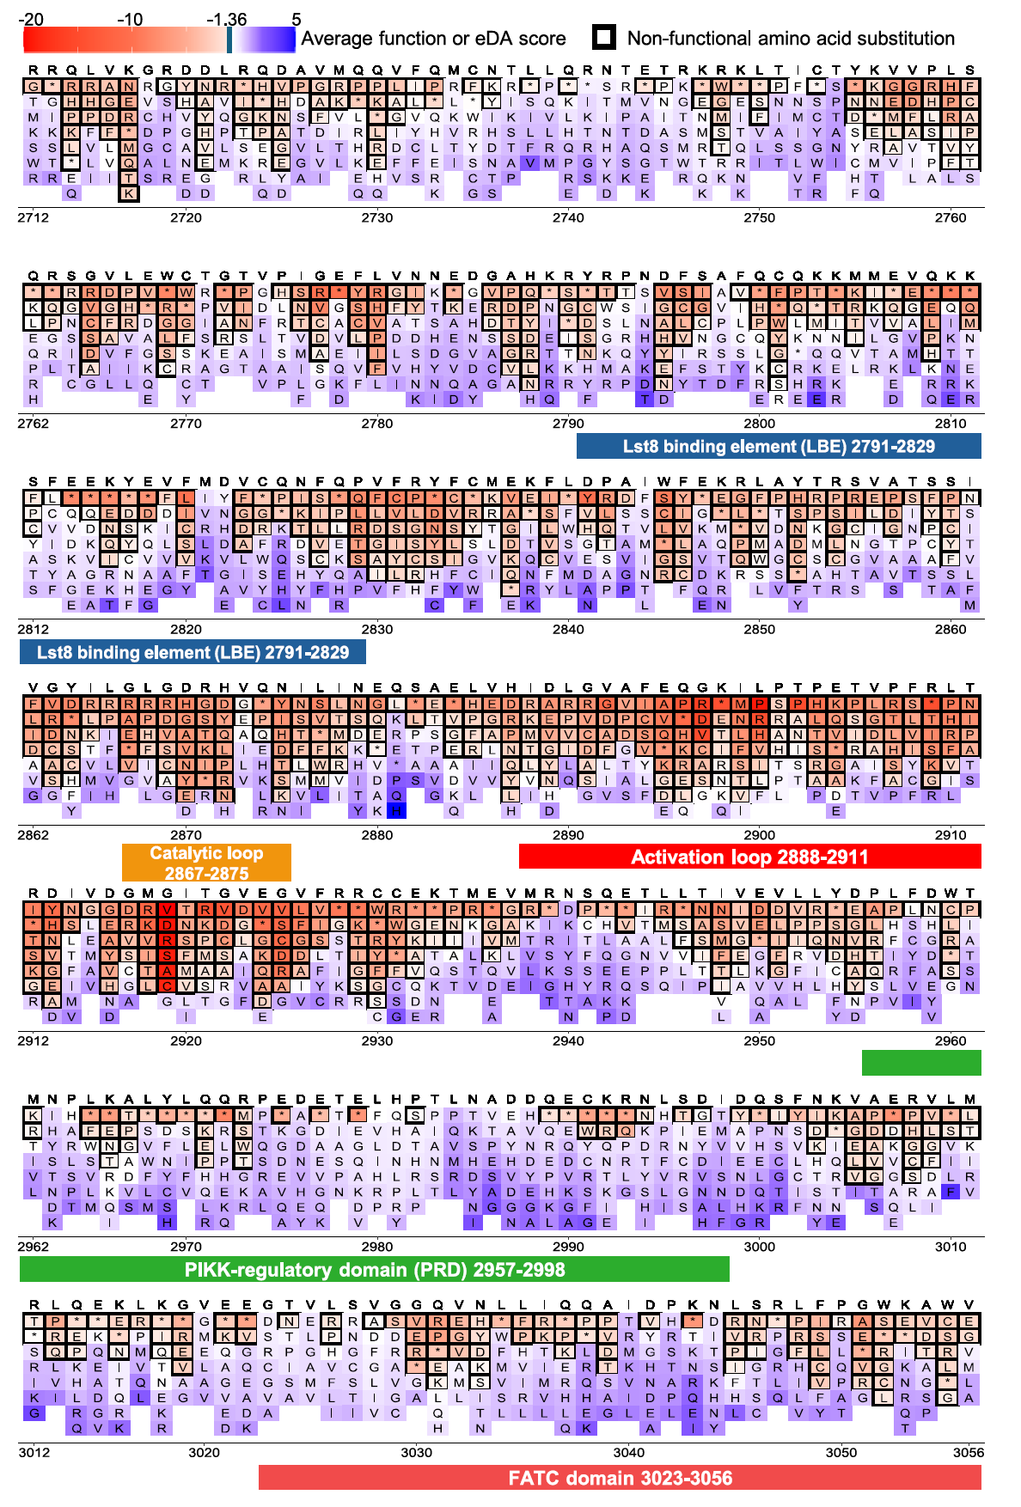
Prime editing: the ideal tool for saturation coding variant screening
Can evaluate function of every possible variant
Allows classification of variants observed in genome sequencing
Example: prime editing evaluation of 23,092 of the 27,513 possible SNVs in ATM, a cancer-associated gene
Lee et al 2025 Cell

Slide 37
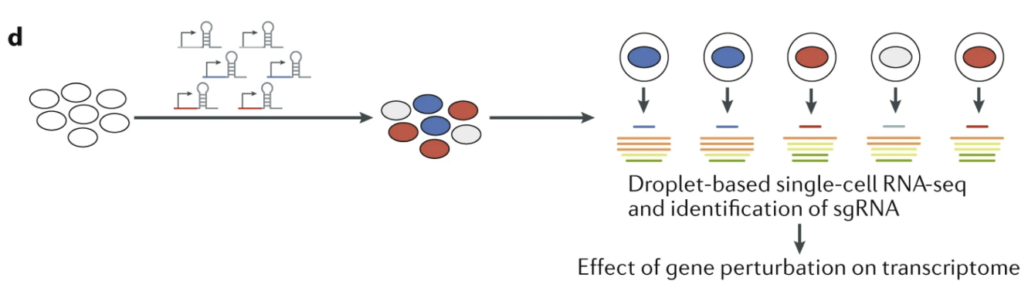
Types of CRISPR screens: single-cell RNA-seq
Kampmann 2020 Nat Rev Neurol

Slide 38
Perturb-seq: CRISPR screening using cellular gene expression as phenotype
Adamson et al 2016 Cell, Dixit et al 2016 Cell

Slide 39
Perturb-seq: CRISPR screening using cellular gene expression as phenotype
Adamson et al 2016 Cell, Dixit et al 2016 Cell

Slide 40
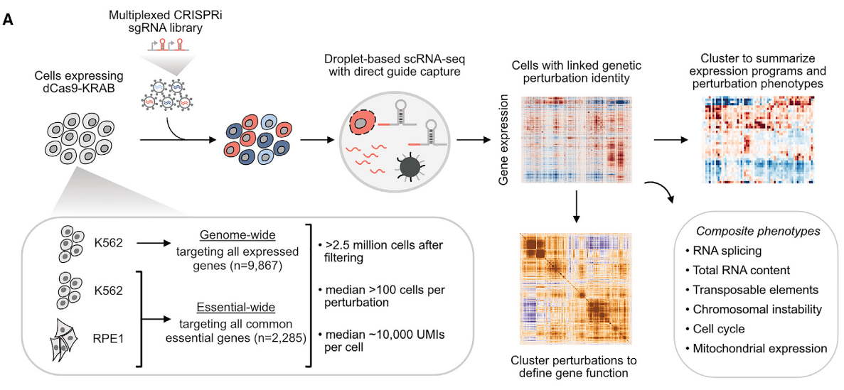
Genome-wide Perturb-seq
Replogle et al 2022 Cell

Slide 41
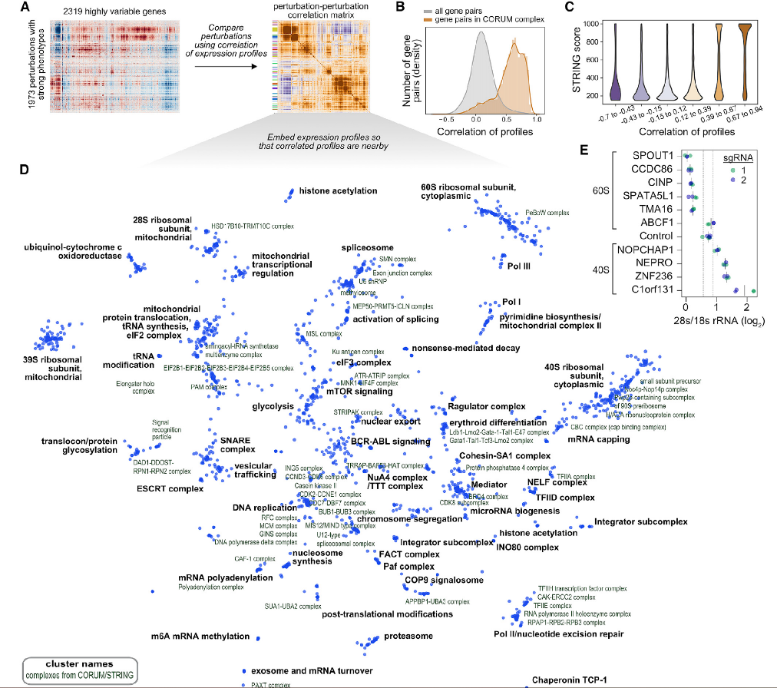
Genome-wide Perturb-seq also clusters genes with similar function
Genes with similar function can be identified through:
Perturb-seq
Co-essentiality
Genetic interaction (dual-gene)
What are advantages and drawbacks of each approach?
Field is too new to have systematic comparisons
Think of assumptions though (e.g. what shared gene expression response might you expect from knockdown of genes affecting vesicle trafficking?)
Replogle et al 2022 Cell

Slide 42
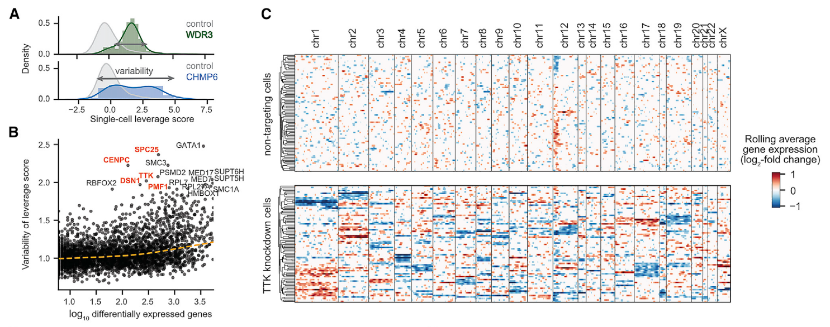
Genome-wide Perturb-seq allows unbiased identification of genes involved in chromosomal stability and aneuploidy
Replogle et al 2022 Cell

Slide 43
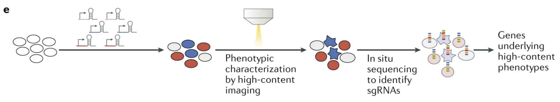
Types of CRISPR screens: imaging readouts
Kampmann 2020 Nat Rev Neurol

Slide 44
Benefits of imaging-based phenotype screens
Feldman et al 2019 Cell

Slide 45
In situ sequencing enables imaging-based phenotype screens
Feldman et al 2019 Cell

Slide 46
An imaging-based screen identifies regulators of signaling pathways
Feldman et al 2019 Cell

Slide 47
Genome-wide multi-phenotype imaging-based CRISPR screening
Funk et al 2022 Cell

Slide 48
Flow cytometry-based imaging screening avoids need for in situ sequencing
Schraivogel et al 2022 Science

Slide 49
Flow cytometry-based imaging screens identify signaling pathway regulators
Schraivogel et al 2022 Science

Slide 50
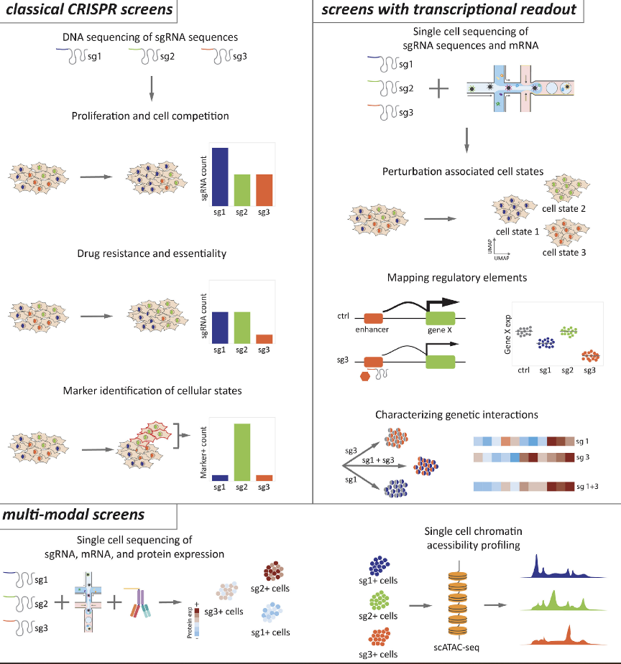
Summary: The wide world of CRISPR screening keeps expanding
Which CRISPR modality to use?
CRISPR-KO
CRISPRi
CRISPRa
Base editing
Prime editing
Emerging technologies (RNA targeting, gene insertion…)
Which phenotypic readout to use?
Cell growth/survival
Drug resistance
scRNA-seq (Perturb-seq)
Imaging
Anything else you can come up with
Kuhn et al 2021 Gene Genome Editing

Slide 51
A large number of cellular properties can be used as phenotypes in screens
Screening macrophage phagocytosis of magnetic beads by holding cells up to magnet
Haney et al 2018 Nat Genet

Slide 52
A large number of cellular properties can be used as phenotypes in screens
Screening how gene knockdown alters DNA repair outcomes
Hussman et al 2021 Cell

Slide 53
Summary: The wide world of CRISPR screening keeps expanding
Which CRISPR modality to use?
CRISPR-KO
CRISPRi
CRISPRa
Base editing
Prime editing
Emerging technologies (RNA targeting, gene insertion…)
Which phenotypic readout to use?
Cell growth/survival
Drug resistance
scRNA-seq (Perturb-seq)
Imaging
Anything else you can come up with
Kuhn et al 2021 Gene Genome Editing

